Slide 1

Week 5: Stack ADT
CS/COE 0445 - Data Structures
Sherif Khattab
http://www.cs.pitt.edu/~skhattab/cs0445
(Some slide contents are © 2016 Pearson Education, Ltd. All rights reserved.
Others are from Dr. Ramirez’s CS 445 course)

Slide 2
Administrivia
Assignment 2 out and due on Mon. 2/19 @11:59pm
Quiz 1 issues

Slide 3
Agenda
Exceptions
Stack ADT

Slide 4
Exception Basics
Method creates an exception object
We say “throws an exception”
Signal to program
Unexpected has happened
Handle the exception
Detect and react

Slide 5
The Basics
Checked exceptions in the Java Class Library
ClassNotFoundException
FileNotFoundException
IOException
NoSuchMethodException
WriteAbortedException

Slide 6
The Basics
Runtime exceptions in the Java Class Library
ArithmeticException
ArrayIndexOutOfBoundsException
ClassCastException
IllegalArgumentException
IllegalStateException
IndexOutOfBoundsException
NoSuchElementException
NullPointerException
StringIndexOutOfBoundsException
UnsupportedOperationException

Slide 7
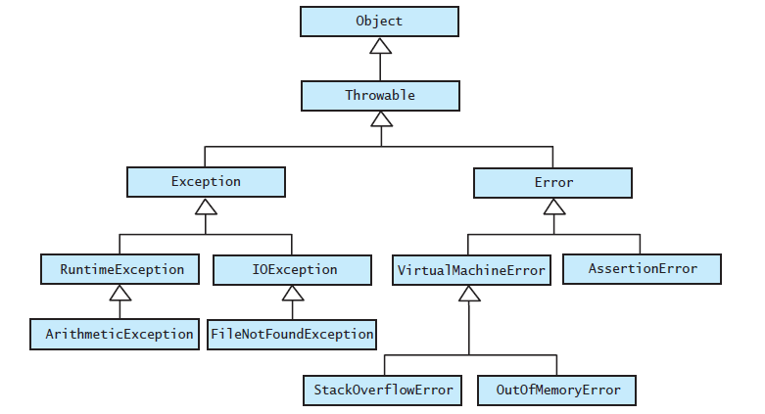
The Basics
FIGURE JI2-1 The hierarchy of some standard exception and error classes

Slide 8

Handling an Exception
Postpone handling: The throws clause
If programmer not sure what action is best for a client when an exception occurs
Leave the handling of the exception to the method’s client
Method that can cause but does not handle checked exception must declare in its header

Slide 9
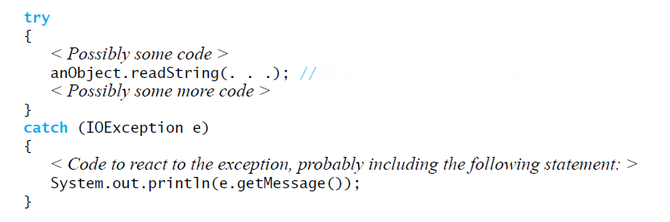
Handle It Now: The try-catch Blocks
Code to handle an IOException as a result of invoking the method readString
Might throw an IOException

Slide 10
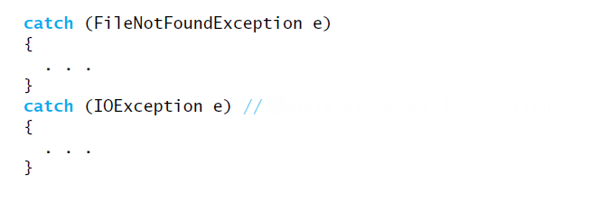
Multiple catch Blocks
Good order for catch blocks
Handle all other IOExceptions

Slide 11

Throwing an Exception
A method intentionally throws an exception by executing a throw statement.
Programmers usually create the object within the throw statement

Slide 12
Throwing an Exception
If you can resolve unusual situation in a reasonable manner
likely can use a decision statement instead of throwing an exception
If several resolutions to abnormal occurrence possible, and you want client to choose
Throw a checked exception
If a programmer makes a coding mistake by using your method incorrectly
Throw a runtime exception

Slide 13
The Stack ADT

Slide 14
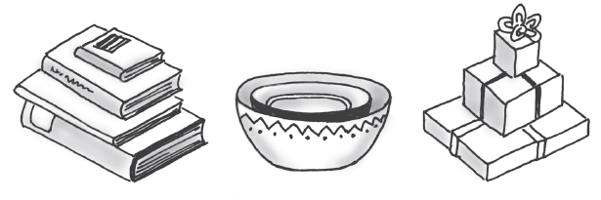
Stacks
FIGURE 5-1 Some familiar stacks
Add item on top of stack
Remove item that is topmost
Last In, First Out … LIFO

Slide 15
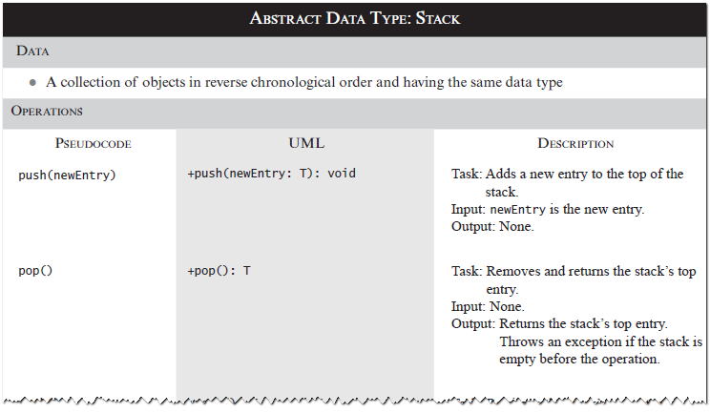
Specifications of the ADT Stack

Slide 16
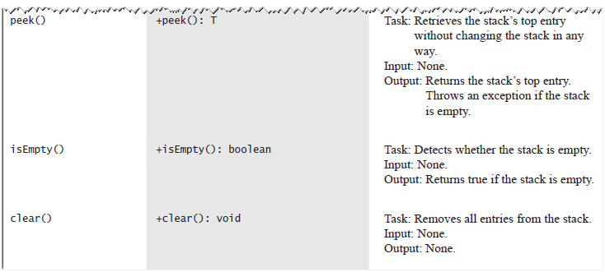
Specifications of the ADT Stack

Slide 17
Design Decision
When stack is empty
What to do with pop and peek?
Possible actions
Assume that the ADT is not empty;
Return null.
Throw an exception (which type?).

Slide 18
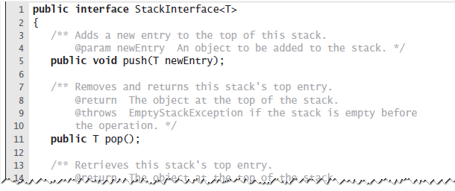
Interface
LISTING 5-1 An interface for the ADT stack

Slide 19
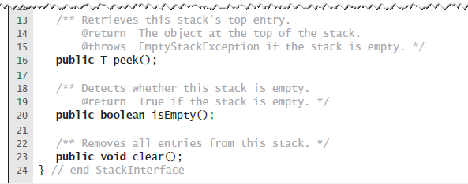
Interface
LISTING 5-1 An interface for the ADT stack

Slide 20
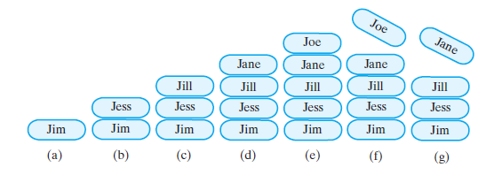
Example
FIGURE 5-2 A stack of strings after (a) push adds Jim; (b) push adds Jess; (c) push adds Jill; (d) push adds Jane; (e) push adds Joe; (f ) pop retrieves and removes Joe; (g) pop retrieves and removes Jane

Slide 21
Security Note
Design guidelines
Use preconditions and postconditions to document assumptions.
Do not trust client to use public methods correctly.
Avoid ambiguous return values.
Prefer throwing exceptions instead of returning values to signal problem.

Slide 22
Processing Algebraic Expressions
Infix: each binary operator appears between its operands a + b
Prefix: each binary operator appears before its operands + a b
Postfix: each binary operator appears after its operands a b +
Balanced expressions: delimiters paired correctly

Slide 23
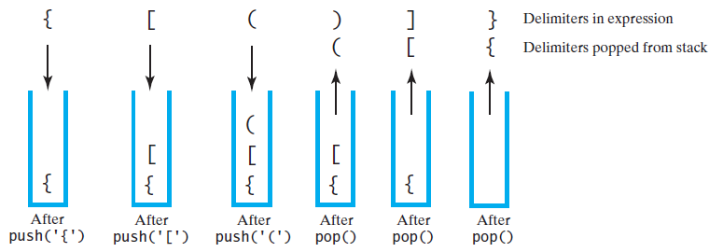
Processing Algebraic Expressions
FIGURE 5-3 The contents of a stack during the scan of an expression that contains the balanced delimiters { [ ( ) ] }

Slide 24
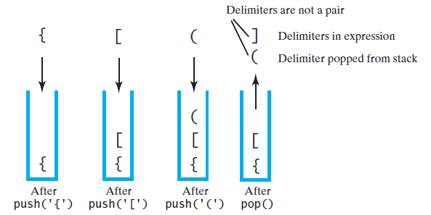
Processing Algebraic Expressions
FIGURE 5-4 The contents of a stack during the scan of an expression that contains the unbalanced delimiters { [ ( ] ) }

Slide 25
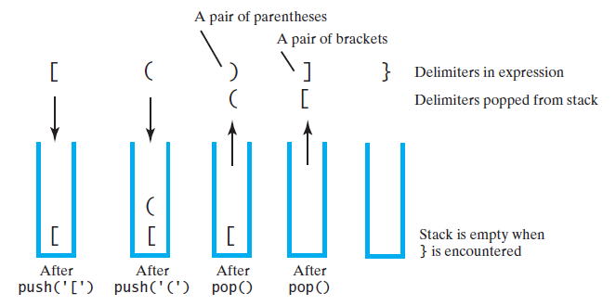
Processing Algebraic Expressions
FIGURE 5-5 The contents of a stack during the scan of an expression that contains the unbalanced delimiters [ ( ) ] }

Slide 26
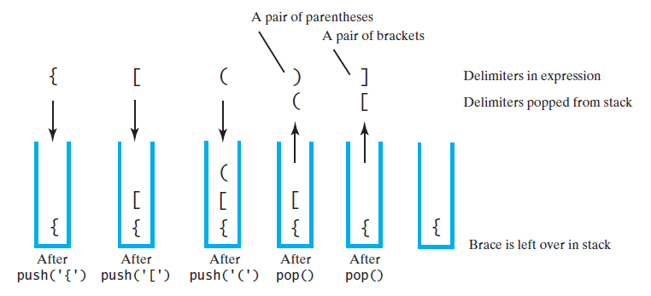
Processing Algebraic Expressions
FIGURE 5-6 The contents of a stack during the scan of an expression that contains the unbalanced delimiters { [ ( ) ]

Slide 27
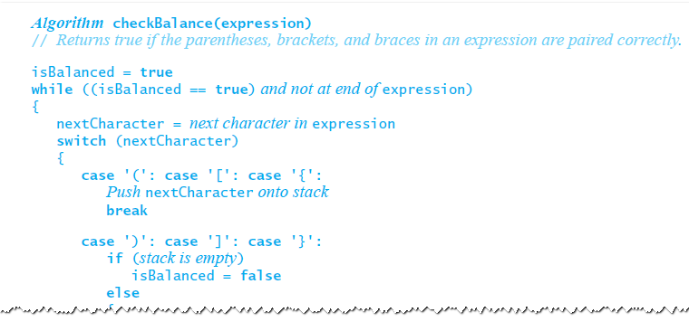
Processing Algebraic Expressions
Algorithm to process for balanced expression.

Slide 28
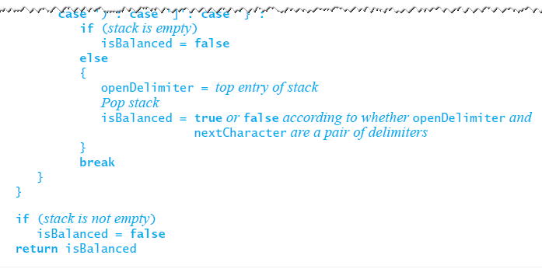
Processing Algebraic Expressions
Algorithm to process for balanced expression.

Slide 29
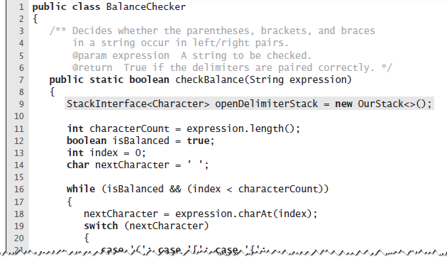
Java Implementation
LISTING 5-2 The class BalanceChecker

Slide 30
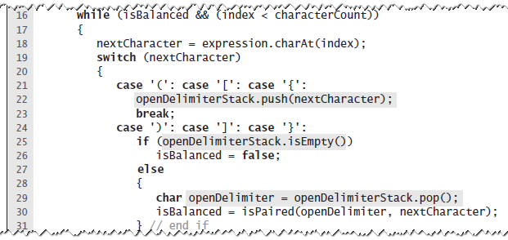
Java Implementation
LISTING 5-2 The class BalanceChecker

Slide 31
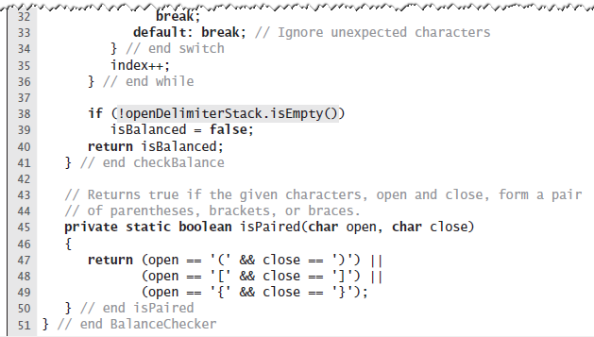
Java Implementation
LISTING 5-2 The class BalanceChecker

Slide 32
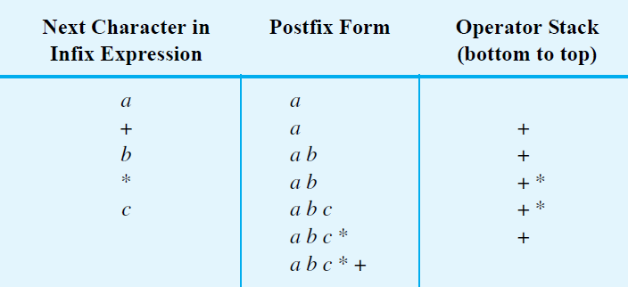
Infix to Postfix
FIGURE 5-7 Converting the infix expression a + b * c to postfix form

Slide 33
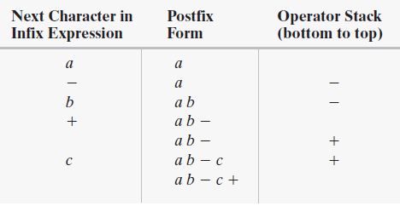
Successive Operators with Same Precedence
FIGURE 5-8 Converting an infix expression to postfix form: (a) a - b + c;

Slide 34
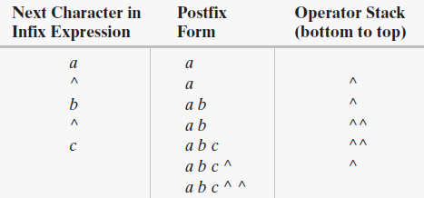
Successive Operators with Same Precedence
FIGURE 5-8 Converting an infix expression to postfix form: a ^ b ^ c

Slide 35
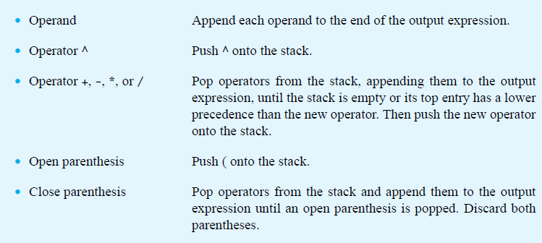
Infix-to-postfix Conversion

Slide 36
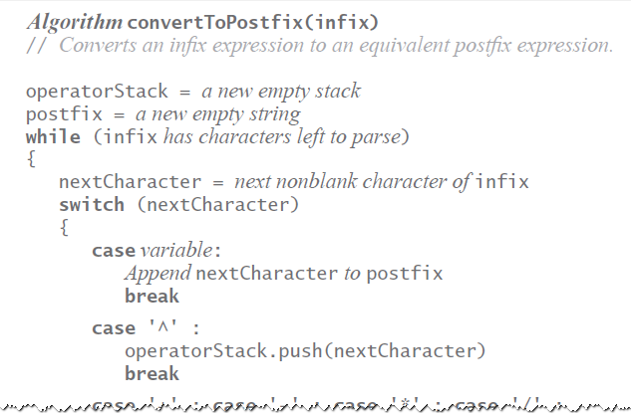
Infix-to-postfix Algorithm

Slide 37
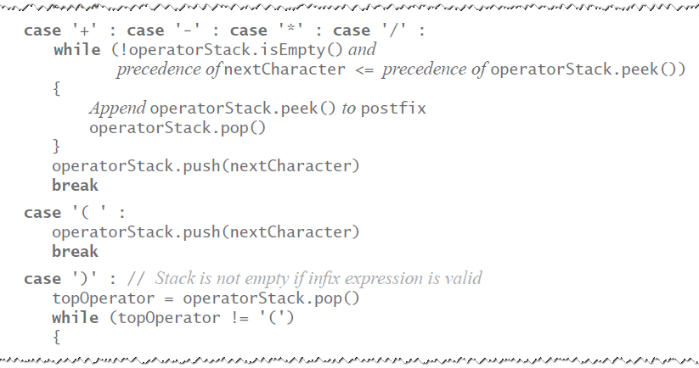
Infix-to-postfix Algorithm

Slide 38
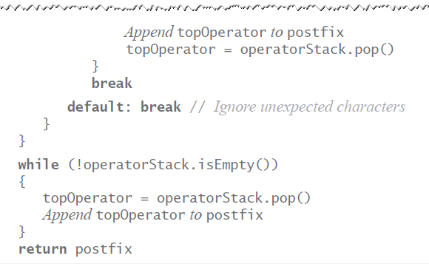
Infix-to-postfix Algorithm

Slide 39
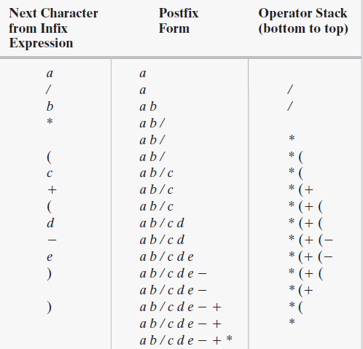
Infix to Postfix
FIGURE 5-9 The steps in converting the infix expression a / b * (c + (d - e)) to postfix form

Slide 40
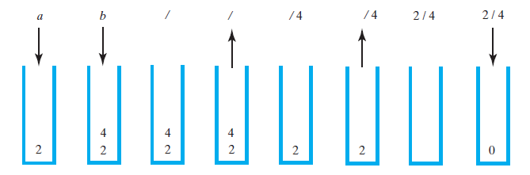
Evaluating Postfix Expressions
FIGURE 5-10 The stack during the evaluation of the postfix expression a b / when a is 2 and b is 4

Slide 41
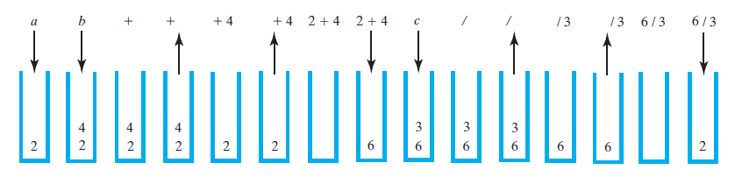
Evaluating Postfix Expressions
FIGURE 5-11 The stack during the evaluation of the postfix expression a b + c / when a is 2, b is 4, and c is 3

Slide 42
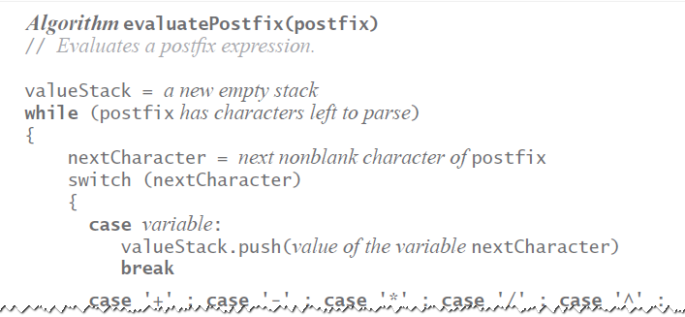
Evaluating Postfix Expressions
Algorithm for evaluating postfix expressions.

Slide 43
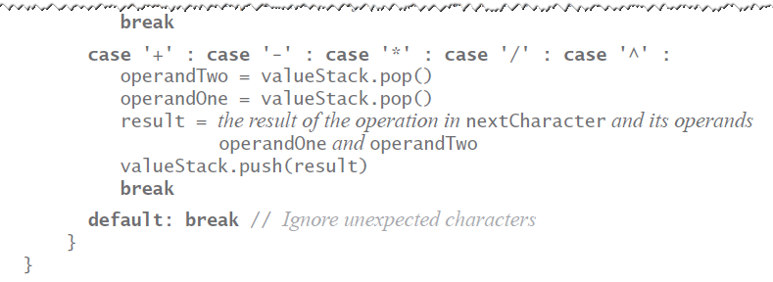
Evaluating Postfix Expressions
Algorithm for evaluating postfix expressions.

Slide 44
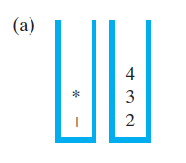
Evaluating Infix Expressions
FIGURE 5-12 Two stacks during the evaluation of a + b * c when a is 2, b is 3, and c is 4:
(a) after reaching the end of the expression;

Slide 45
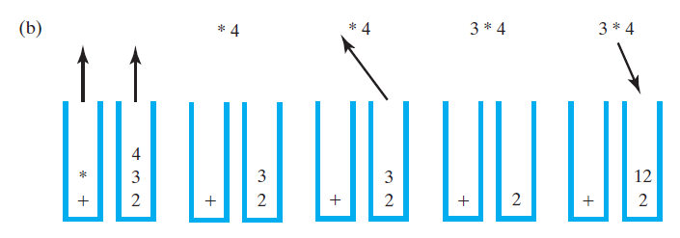
Evaluating Infix Expressions
FIGURE 5-12 Two stacks during the evaluation of a + b * c when a is 2, b is 3, and c is 4: (b) while performing the multiplication;

Slide 46
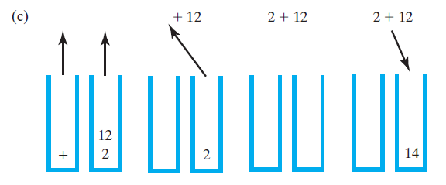
Evaluating Infix Expressions
FIGURE 5-12 Two stacks during the evaluation of a + b * c when a is 2, b is 3, and c is 4: (c) while performing the addition

Slide 47
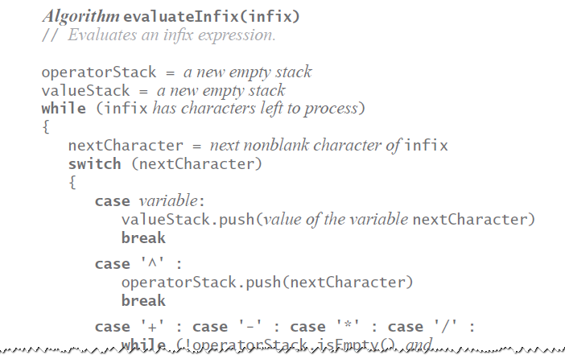
Evaluating Infix Expressions
Algorithm to evaluate infix expression.

Slide 48
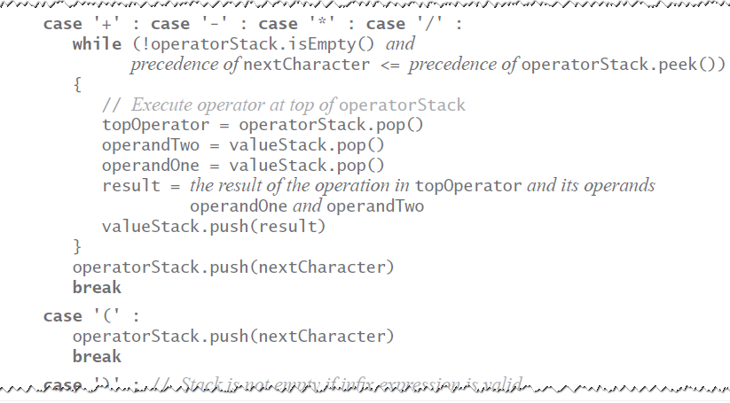
Evaluating Infix Expressions
Algorithm to evaluate infix expression.

Slide 49
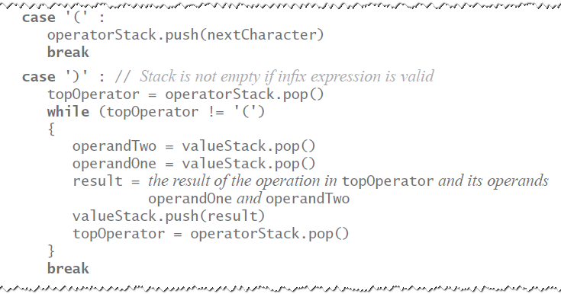
Evaluating Infix Expressions
Algorithm to evaluate infix expression.

Slide 50
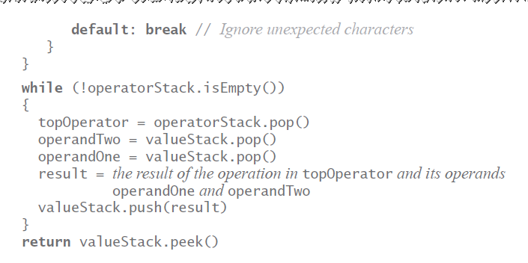
Evaluating Infix Expressions
Algorithm to evaluate infix expression.

Slide 51
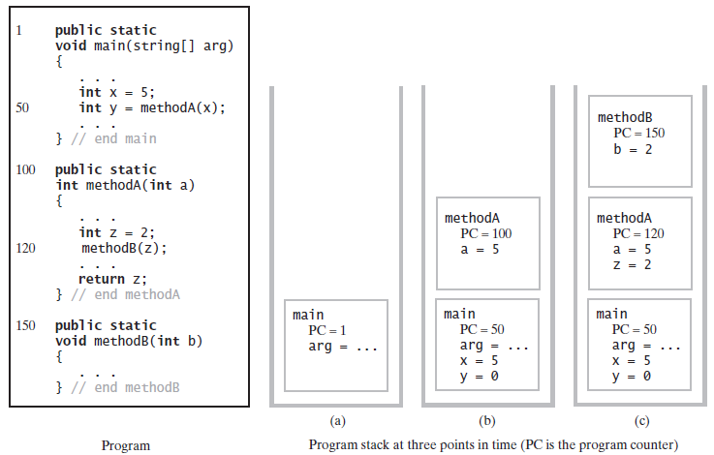
The Program Stack
FIGURE 5-13 The program stack at three points in time: (a) when main begins execution; (b) when methodA begins execution; (c) when methodB begins execution

Slide 52
Java Class Library:The Class Stack
Found in java.util
Methods
A constructor – creates an empty stack
public T push(T item);
public T pop();
public T peek();
public boolean empty();

Slide 53
Linked Implementation
Each operation involves top of stack
push
pop
peek
Head of linked list easiest, fastest to access
Let this be the top of the stack

Slide 54
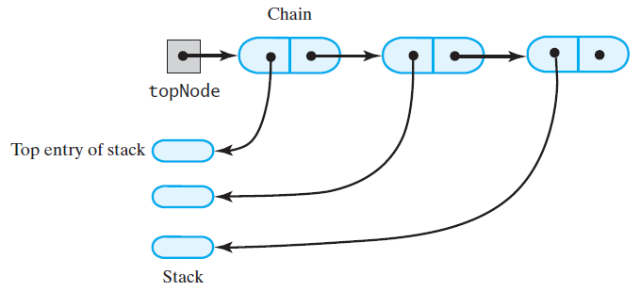
Linked Implementation
FIGURE 6-1 A chain of linked nodes that implements a stack

Slide 55
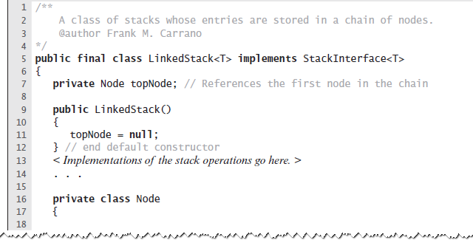
Linked Implementation
LISTING 6-1 An outline of a linked implementation of the ADT stack

Slide 56
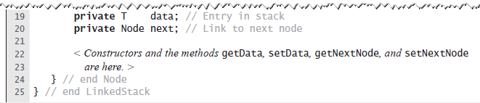
Linked Implementation
LISTING 6-1 An outline of a linked implementation of the ADT stack

Slide 57
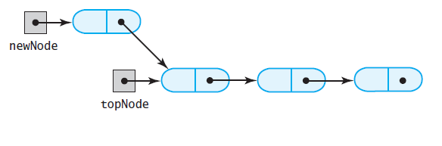
Linked Implementation
FIGURE 6-2 (a) A new node that references the node at the top of the stack;
(a)

Slide 58
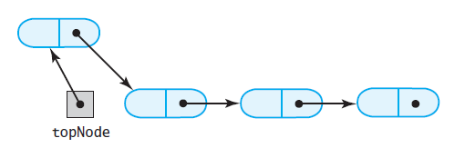
Linked Implementation
FIGURE 6-2 (b) the new node is now at the top of the stack
(b)

Slide 59
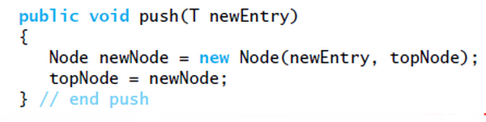
Linked Implementation
Definition of push

Slide 60
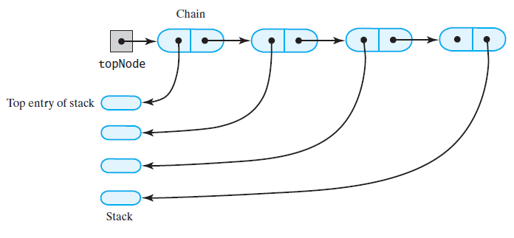
Linked Implementation
FIGURE 6-3 The stack (a) before the first node in the chain is deleted
(a)

Slide 61
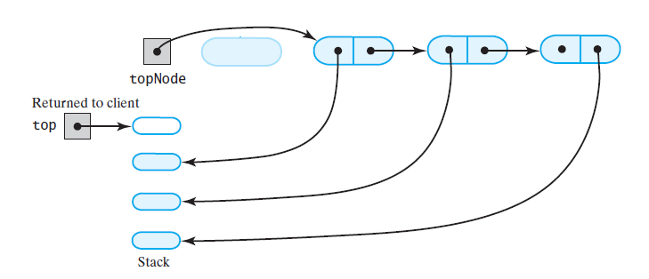
Linked Implementation
FIGURE 6-3 The stack (b) after the first node in the chain is deleted
(b)

Slide 62
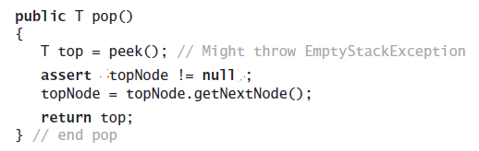
Linked Implementation
Definition of pop

Slide 63
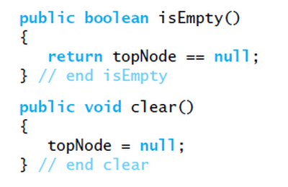
Linked Implementation
Definition of rest of class.

Slide 64
Array-Based Implementation
Each operation involves top of stack
push
pop
peek
End of the array easiest to access
Let this be top of stack
Let first entry be bottom of stack

Slide 65
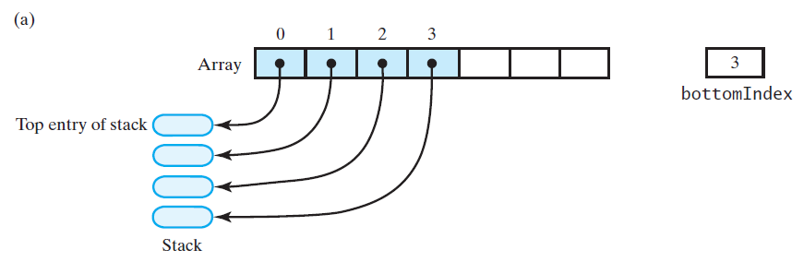
Array-Based Implementation
FIGURE 6-4 An array that implements a stack; its first location references (a) the top entry in the stack;

Slide 66
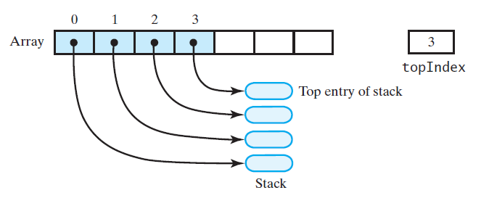
Array-Based Implementation
FIGURE 6-4 An array that implements a stack; its first location references (b) the bottom entry in the stack
(b)

Slide 67

Array-Based Implementation
LISTING 6-2 An outline of an array-based implementation of the ADT stack

Slide 68

Array-Based Implementation
LISTING 6-2 An outline of an array-based implementation of the ADT stack

Slide 69

Array-Based Implementation
Adding to the top.

Slide 70

Array-Based Implementation
Retrieving the top, operation is O(1)

Slide 71

Array-Based Implementation
FIGURE 6-5 An array-based stack after its top entry is removed by (a) decrementing topIndex;

Slide 72

Array-Based Implementation
FIGURE 6-5 An array-based stack after its top entry is removed by (b) setting stack[topIndex] to null and then decrementing topIndex

Slide 73

Array-Based Implementation
Removing the top

Slide 74
Vector Based Implementation
Vector: an object that behaves like a high-level array
Index begins with 0
Methods to access or set entries
Size will grow as needed
Use vector’s methods to manipulate stack

Slide 75

Vector Based Implementation
FIGURE 6-6 A client using the methods given in StackInterface; these methods interact with a vector’s methods to perform stack operations

Slide 76
The Class Vector
Constructors
Has methods to add, remove, clear
Also methods to determine
Last element
Is the vector empty
Number of entries

Slide 77

Vector Based Implementation
LISTING 6-3 An outline of a vector-based implementation of the ADT stack

Slide 78

Vector Based Implementation
LISTING 6-3 An outline of a vector-based implementation of the ADT stack

Slide 79

Vector Based Implementation
Adding to the top

Slide 80

Vector Based Implementation
Retrieving the top

Slide 81

Vector Based Implementation
Removing the top

Slide 82

Vector Based Implementation
The rest of the class.

